Slide 1

Product Presentation

Slide 2

This short presentation is the results of a very long and educative process.
Here is a demonstration of the basics steps and usages of our app.
The app is develop for android OS, and presented here on Eclipse virtual machine for Nexuses 7.

Slide 3
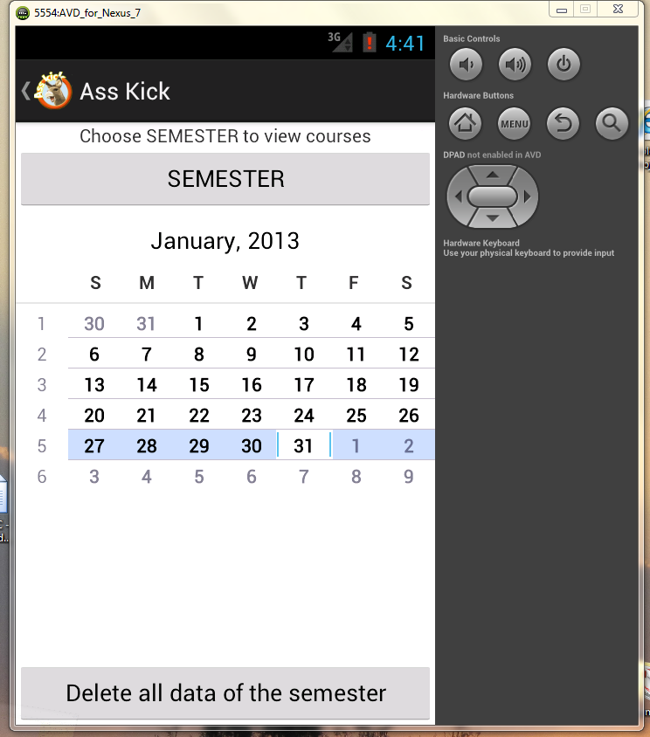
LET’S START - Initiate a Semester
This is the app’s first landing screen.
The native calendar is shown.
New ‘SEMSTER’ is created in 1 click.

Slide 4
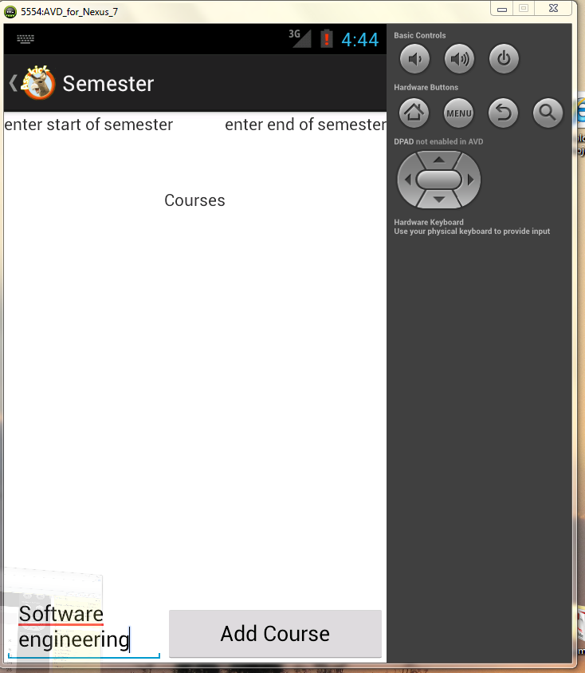
Add courses
The app will check and notify by toast messages, for invalid input.
The data for each course is saved in a separated file.
These data files can easily be erased for main screen

Slide 5
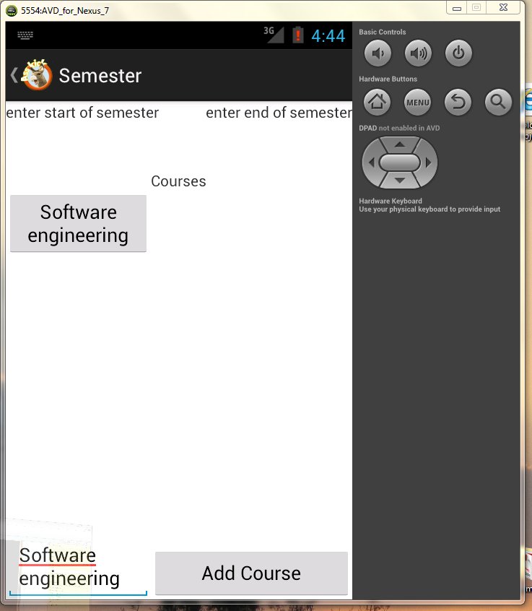
Add task to a course
Once you have a course or courses, click on one..

Slide 6
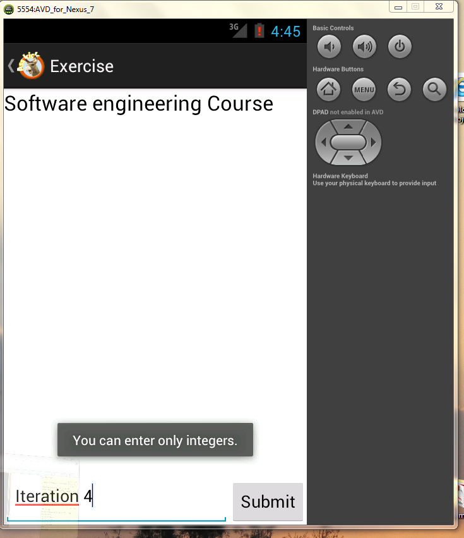
Add task to a course
Enter number of tasks for a course.
The app will check for a valid input, and notify by toast messages for invalid input.

Slide 7
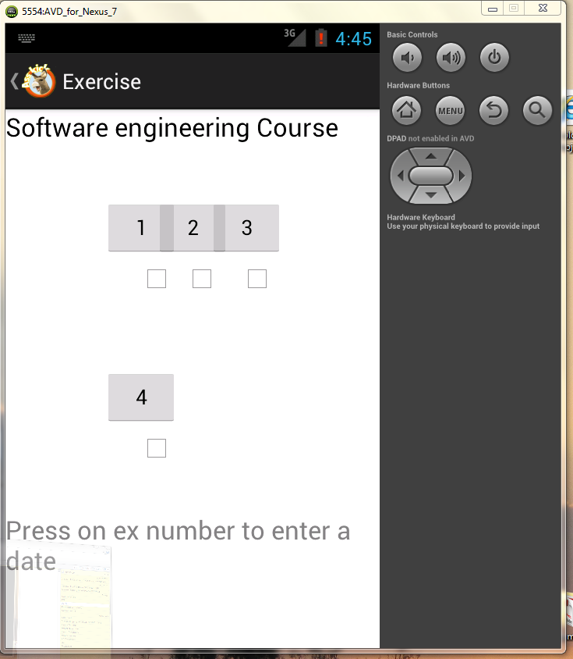
Add task to a course
Now you have tasks asigned to the course.
Click on a task to set alarms and due date.

Slide 8
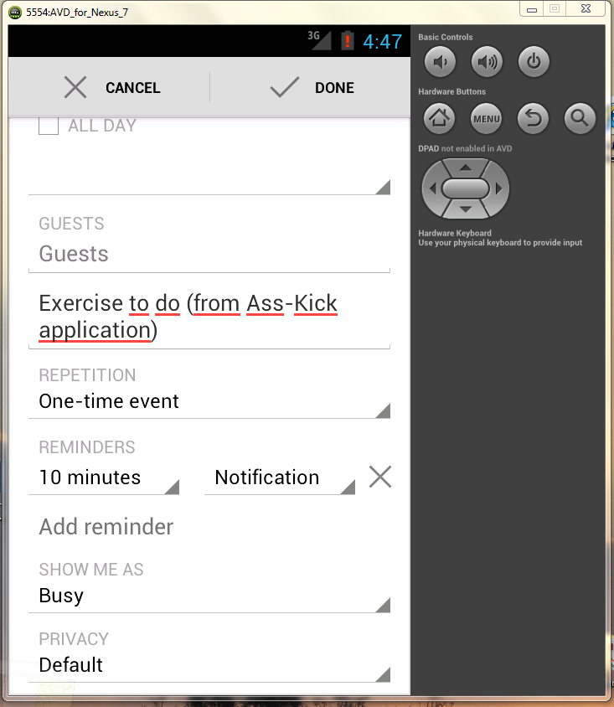
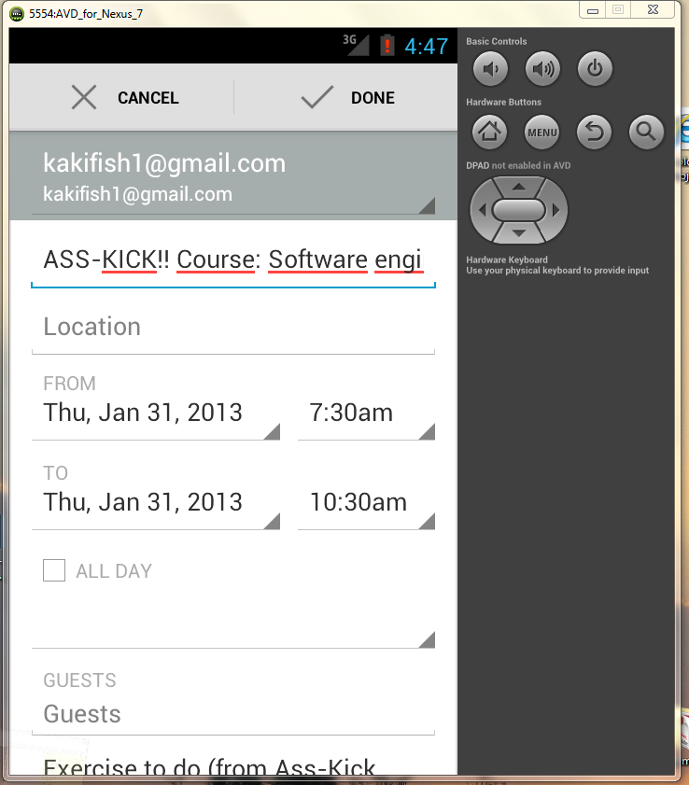
Task settings
Integrated with the android native calendar

Slide 9
Thank you!

